Slide 1
CN8861 Network & Service Management Spring 2013
Govi Ravindran
Nishant Patel
Dept. of Electrical & Computer Engineering
Ryerson University

Slide 2
Background
PhD (ECE), University of Toronto
Adjunct Faculty, ECE, Ryerson (’01-’08)
Teaching (‘05-’10)
Industrial experience (‘98-Present)
Application Development
Network Management Systems Design
Telecom Services Design and Deployment

Slide 3
Course Objective
Introduce Network Management concepts, technology, and tools.
Learn to specify, design, administer, and implement network management systems.
Prepare for jobs at Carriers, NEM, and MSOs.
Obtain vendor certifications.
http://www.cn.ryerson.ca/courses/8861.htm

Slide 4
Course Overview
Detailed study of SNMP protocol and architectures.
Focuses on both agent and manager design.
Introduces commercial and open source network management tools.

Slide 5
Course Outline
Introduction
Building blocks
Standardization & Framework
The OSI Network Management Model
CMIP, MIT, FCAPS
FCAPS
The Telecommunication Management Network (TMN) Framework
Element, Network, Service Management
IETF Management Framework
SNMP, MIB, SMI

Slide 6
Course Outline (contd.)
TCP/IP Management: SNMP Overview (v1, v2c)
Evolution of SNMP Management standards
SNMP Framework
SNMP Protocol Messages (v1, v2c)
Structure of Management Information (SMI)
Management Information Base (MIB)
TCP/IP Management: SNMPv3
SNMPv3 Message Format
User Based Security Model (USM)
View Based Access Control Model (VACM)
SNMP Applications
SNMPv3 MIB Modules

Slide 7
Course Outline (contd.)
Tools
HP Openview Network Node Manager
Network Infrastructure Monitoring
Integration Points
Data Collection Configuration, Configuring Actions for Events, and Event Correlation
Scalability, distributed management
Net-SNMP Extensible Agent Development Kit
Command Line Applications
Nagios
IT Infrastructure Monitoring

Slide 8
Course Outline (contd.)
Advanced Topics
Distributed Network Management Architectures
Management by Delegation
Script MIB (Delegation of Management Scripts)
Schedule MIB (Scheduling Management Operations)
SLA Management
Agent Extension
Event MIB
Expression MIB

Slide 9
Course Evaluation
20% - Assignment
2 Assignments
30% - Midterm Quiz
26th May
40% - Group Presentation
9th June
10% - Class Participation

Slide 10
Group Presentation
Research, design and present on a topic related to course material.
Example topics
Tools (Nagios, SNMPc, MRTG, NNM)
Data Center Management
NETCONF
Groups of 3 or 4
Deliverables
Presentation.
Demonstration, if any.

Slide 11
Useful Websites
http://www.simpleweb.org/
RFCs, Tutorials, & Whitepapers
Links to open source tools, research thesis
Bibliography
http://www.ietf.org
Operations & Management Working Group
http://www.net-snmp.org
SNMP Agent toolkit
Vendor websites
Cisco, HP

Slide 12
References - Books
Douglas R. Mauro, Kevin J. Schmidt, “Essential SNMP”, O’Reilly
David Zeltserman, “A Practical Guide to SNMPv3 and Network Management”, Prentice Hall
David T. Perkins, Evan McGinnis, “Understanding SNMP MIBs”, Prentice-Hall

Slide 13
RFC References – Lecture 1
SNMPv1
RFC 1155, “Structure and Identification of Management Information (SMIv1) for TCP/IP based internets”.
RFC 1157, “Simple Network Management Protocol”.
RFC 1213, “Management Information Base for Network Management of TCP/IP internets: MIB-II”.

Slide 14
Section 1 Introduction

Slide 15
What is Network Management?
Network Management is a service that employs a variety of tools, applications, and devices to assist human network managers in monitoring and maintaining networks.

Slide 16
Network Management Motivation
Why is it needed?
In a perfect world, networks would not need management -they would just run themselves.
However…
Parts tend to break
Changes are made
Somebody has to pay
Performance below expectation
Abuse happens
Management Areas
Fault Management
Configuration Management
Accounting Management
Performance Management
Security Management

Slide 17
Network Management Elements
Consists of Managers and Agents.
Managers (or Management Stations)
Employ automatic or user initiated polling of managed devices.
Agents
Gather and store information about the managed resources
Provide information to Managers on demand.
Send alerts to Managers when events of interest occur.

Slide 18
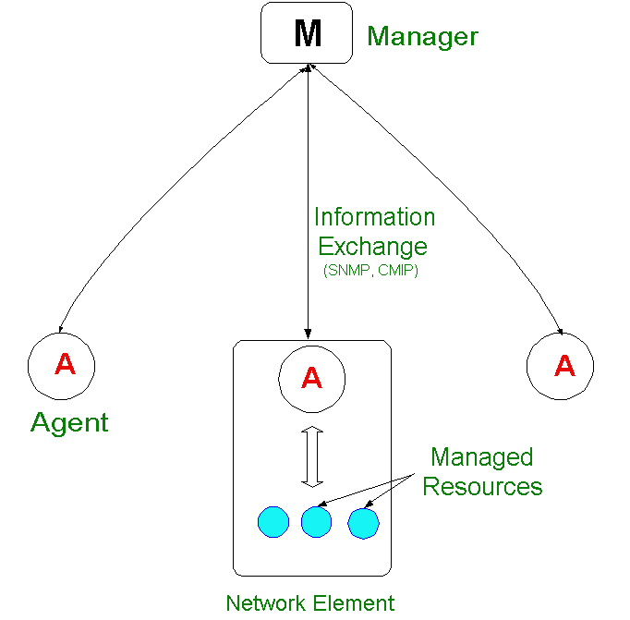
Network Management Elements

Slide 19
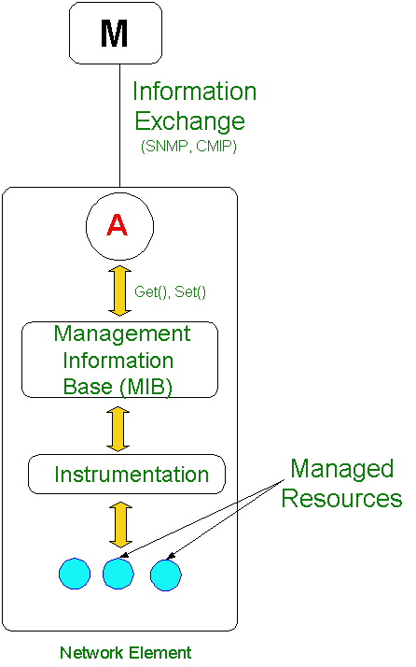
Management Information Base

Slide 20
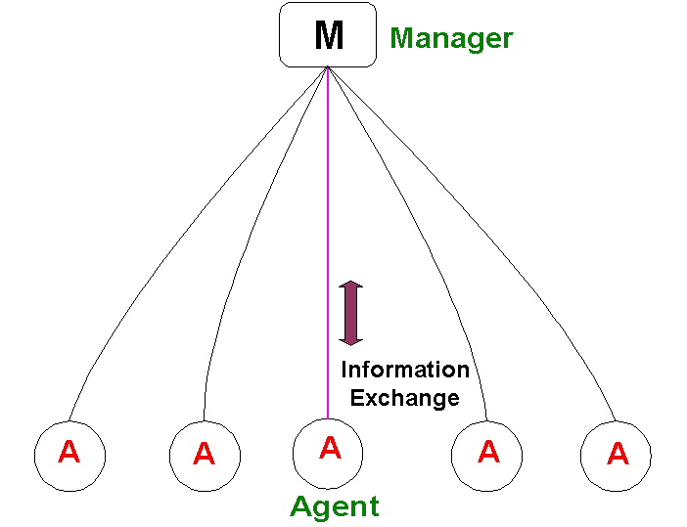
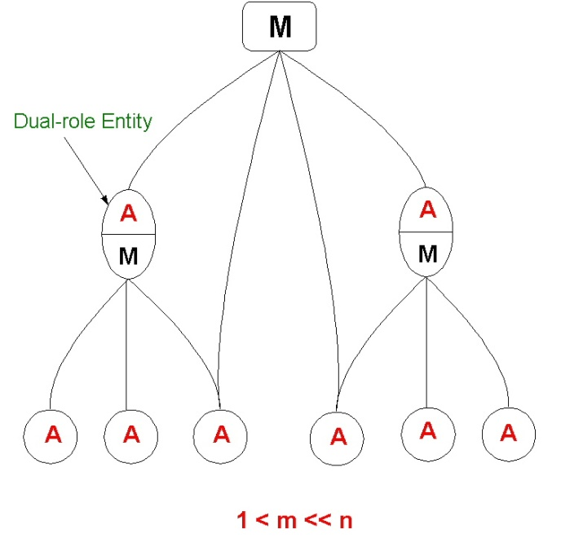
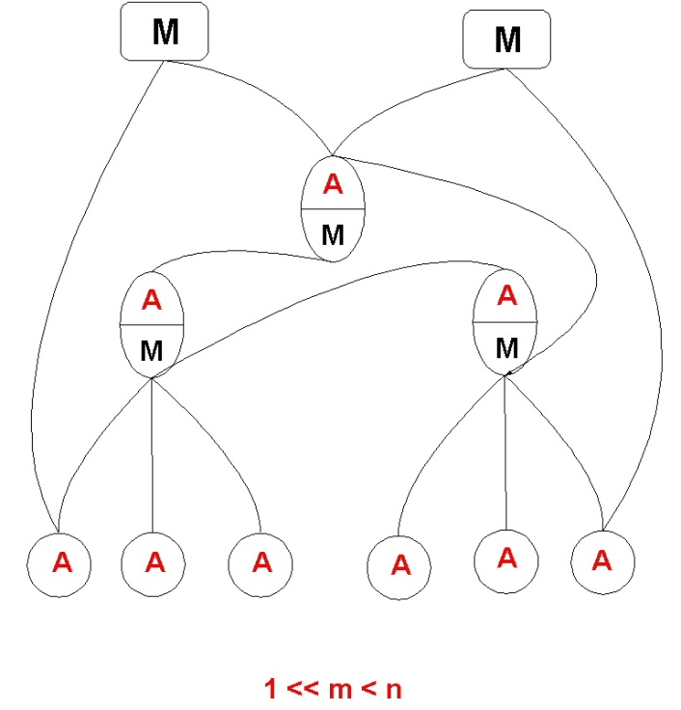
Network Management Architectures
Centralized
Weakly
Distributed
Strongly
Distributed

Slide 21
Network Management Framework
An overall architecture
Consisting of manager(s) and managed devices.
A repository of managed objects
Management Information Base (MIB)
Mechanism for describing and naming managed objects and events.
Structure of Management Information (SMI)
Protocol for transferring management information.
Simple Network Management Protocol (SNMP)
A number of general-purpose/standard MIBs.

Slide 22
Section 2 Network Management Standards

Slide 23
Overview
International Organization for Standardization (ISO)
ITU Telecommunication Standardization Sector (ITU-T)
Internet Engineering Task Force (IETF)
Industry Consortiums
Tele-Management Forum (TMF)

Slide 24
ISO Standardization
ISO WG 4
http://www.iso.org
Defined the OSI Network Management Model
Management should be powerful
Object oriented approach
Reliable exchange of management information
CMIP, MIT

Slide 25
OSI Management Model
Functional Component (FCAPS)
Fault Management
Configuration Management
Accounting Management
Performance Management
Security Management
Information Component
Management Information Tree (MIT)
Communication Component
Common Management Information Protocol (CMIP)
Common Management Information Service (CMIS)

Slide 26
OSI Functional Component
Fault Management
Detection and recovery of network anomalies and failures.
Configuration Management
Provision network resources and services.
Accounting Management
Collect usage data for the resources used; generate associated tariff.
Performance Management
Monitor performance parameters, collect traffic statistics.
Security Management
prevention and detection of improper access/use of network resources and services

Slide 27
OSI Management Information Tree
Instances of Managed Objects (MO) organized in a hierarchical tree.
An unique Distinguishing Name (DN) identifies an MO instance.
DN is used by CMIP to identify and access managed information
Start
Diagnose
Stop
State
Uptime
MO
Instance
Cold
Start
Location
Name

Slide 28
OSI Communication Component
Attributes
Operations
MO Instances
Notifications
Event Detection
Agent
Selector
Event Forwarding
Get/Set/Action
Event Notification
CMIP
CMIS

Slide 29
OSI Communication Component
System A
System B
System C
MIT
M
A
M
A
CMIS
CMIP
CMIP
Operations/
Notifications
Operations/
Notifications
OSI
Protocol
Stack
Managed Objects

Slide 30
CMIP Operations
M-INITIALIZE
Establish Management Session
M-TERMINATE
Terminate Management Session
M-ABORT
Unconfirmed Termination
M-CREATE
Creates an Instance MO instance
M-DELETE
Deletes an MO instance

Slide 31
CMIP Managed Information Exchange
M-GET
Retrieve information
M-CANCEL-GET
Cancel retrievals
M-SET
Change an attribute value
M-ACTION
Invoke an MO operation
M-EVENT-REPORT
Generate an MO event report to a manager

Slide 32
ITU-T Standardization
Defined the TMN framework
Uses OSI Network Management Model
Support for Operations, Administration, Maintenance, and Provisioning (OAMP) of Telecommunications networks
Logically separate network for management and interfaces with the Telecommunications network at several distinct point
http://www.itu.int/itu-t

Slide 33
TMN Logical Layers
Business Management
Service Management
Network Management
Element Management
Network
Elements

Slide 34
IETF Standardization
IETF O&M Working Group
Defined the SNMP Management Standard
Management should be simple
Variable oriented approach
Management information exchanges may be unreliable
SNMPv1, SNMPv2c, SNMPv3
SMI, MIB
http://www.ietf.org

Slide 35
IETF Core SNMP RFCs
SNMP Protocol Specification
Version 1 – RFC 1157
Version 2 – RFCs 1901, 1902, 1903, 1904, 1905, 1906, 1907
Version 3 – RFCs 3411, 3412, 3413, 3414, 3415
SMI
Structure of Management Information.
SMIv1 - RFC 1155
SMIv2 – RFC 2578
MIB-II
Managed Object definitions for TCP/IP-based internets – RFC 1213
IETF standard MIBs

Slide 36
SNMP Management
Management Station
Managed Device
Management
Application
Application
Manages Objects
Managed Resources
Managed Objects (MIB)
Get
GetNext
Trap
GetResponse
Get
GetNext
Trap
Set
GetResponse
Set
SNMP Messages
SNMP
SNMP
UDP
UDP
IP
IP
Link Layer
Link Layer

Slide 37
SNMP Proxy Management
Management
Station
Proxied
Device
Proxy Agent
Manager
Process
Mapping Function
Agent
Process
Agent Process
SNMP
SNMP
Proxy
Device
Protocol
Proxy
Device
Protocol
UDP
UDP
IP
IP
Link Layer
Link Layer
Link Layer
Link Layer

Slide 38
SNMP Agent and Manager
A typical SNMP Agent
Implements full SNMP protocol
Stores and retrieves management data
Asynchronously signals events to a manager
A typical SNMP Manager
Implements full SNMP protocol
Get response from agents
Set variables in agents
Receive events from agents

Slide 39
IETF SNMP Standardization - Goal
Ubiquity
Inclusion of management should be inexpensive
Small code
Limited functionality
Management extensions should be possible
New MIBs
Management should be robust
Connectionless transport

Slide 40
IETF SNMP Standardization - Reasons for Success
Rapid development of standards
Standards are obtained freely
Several prototypes demonstrating the feasibility of standards.

Slide 41
Comparing Standardization Processes
ISO/OSI
IETF
Working
Document
Working
Document
No Implementation
Required
Committee
Draft
Implementation
Experience is a must
Proposed
Standard
Technical Report
Historical
After a max of
2 years
No Implementation
Required
Draft
Standard
Several Independent
Implementations must
Interwork
Draft
Standard
Technical Report
After a max of
4 years
Historical
Full
Standard
Full
Standard

Slide 42
Section 3 SNMP Managed Objects

Slide 43
Management Information Base (MIB)
Managed objects are accessed via a virtual information store, referred to as the Management Information Base (MIB).
MIB also refers to a collection of definitions of managed object.
ASN.1 notation is used to define MIB objects data types and values
ASN.1 does not specify how these objects are encoded into strings of ones and zeros. SNMP uses the Basic Encoding Rules (BER).

Slide 44
Structure of Management Information (SMI)
SMI specifies a set of rules for defining managed objects.
RFC 1155 specifies SMIv1
RFC 2578 specifies SMIv2
All managed objects are arranged in a hierarchical tree structure.
An object’s location in this tree structure identifies how to access this object

Slide 45
SMIv1 Managed Object Definition
An Object type definition consists of five fields:
A textual name..
SYNTAX, the object data type:
Uses a subset of the ASN.1 notation
INTEGER, OCTET STRING, or OBJECT IDENTIFIER
ACCESS, how the object may be accessed
read-only, read-write, write-only, or not-accessible
STATUS, implementation requirement
mandatory, optional, or obsolete
DESCRIPTION, textual description of the managed object.

Slide 46
SMIv1 Primitive Data Types
Only the following ASN.1 data types are permitted:
INTEGER
OCTET STRING
OBJECT IDENTIFIER
Enumerated INTEGERs are allowed
SEQUENCE is permitted for defining tables:
SEQUENCE OF <entry>, where <entry> resolves to a list.

Slide 47
SMIv1 Managed Object Definition
ifNumber OBJECT-TYPE
SYNTAX INTEGER
ACCESS read-only
STATUS mandatory
DESCRIPTION
"The number of network interfaces (regardless of their current state) present on this system."
::= { interfaces 1 }

Slide 48
SMIv1 Managed Object Definition
sysObjectID OBJECT-TYPE
SYNTAX OBJECT-IDENTIFIER
ACCESS read-only
STATUS mandatory
DESCRIPTION
"The vendor's authoritative identification of the network management subsystem contained in the entity. This value is allocated within the SMI enterprises subtree (1.3.6.1.4.1)and provides an easy and unambiguous means for determining `what kind of box' is being managed.”
::= { system 2 }

Slide 49
SMIv1 Managed Object Definition
ifTable OBJECT-TYPE
SYNTAX SEQUENCE OF IfEntry
ACCESS not-accessible
STATUS mandatory
DESCRIPTION
"A list of interface entries. The number of entries is given by the value of ifNumber."
::= { interfaces 2 }
ifEntry OBJECT-TYPE
SYNTAX IfEntry
ACCESS not-accessible
STATUS mandatory
DESCRIPTION
"An interface entry containing objects at the subnetwork layer and below for a particular interface."
INDEX { ifIndex }
::= { ifTable 1 }

Slide 50
SMIv1 Abstract Data Types
IpAddress
IMPLICIT OCTET STRING (SIZE(4))
4-byte OCTET STRING
TimeTicks (hundredths of seconds)
IMPLICIT INTEGER
32-bit non-negative integer (0..2³²-1)
Wraps around every 497 days
Counter (this wraps)
IMPLICIT INTEGER
32-bit non-negative integer (0..2³²-1)
Gauge (this doesn’t wrap)
IMPLICIT INTEGER
32-bit non-negative integer (0..2³²-1)

Slide 51
SMIv1 Managed Object Definition
sysUpTime OBJECT-TYPE
SYNTAX TimeTicks
ACCESS read-only
STATUS mandatory
DESCRIPTION
"The time (in hundredths of a second) since the network management portion of the system was last re-initialized."
::= { system 3 }

Slide 52
SMIv1 Managed Object Definition
IfEntry ::= SEQUENCE {
ifIndex
INTEGER,
ifDescr
DisplayString,
ifType
INTEGER,
ifMtu
INTEGER,
ifSpeed
Gauge,
...
}
ifDescr OBJECT-TYPE
SYNTAX DisplayString (SIZE (0..255))
ACCESS read-only
STATUS mandatory
DESCRIPTION
"A textual string containing information about the interface. This string should include the name of the manufacturer, the product name and the version of the hardware interface."
::= { ifEntry 2 }

Slide 53
Textual Conventions
Similar to the abstract data type.
Each of the Textual Convention has more precise semantics and used for the convenience of humans reading the MIB module.
RFC 2579 – “Textual Conventions for SMIv2”
PhysAddress ::= TEXTUAL-CONVENTION
DISPLAY-HINT "1x:"
STATUS current
DESCRIPTION "Represents media- or physical-level addresses."
SYNTAX OCTET STRING

Slide 54
Textual Conventions
DisplayString SYNTAX OCTET STRING (SIZE (0..255))
PhysAddress SYNTAX OCTET STRING
MacAddress SYNTAX OCTET STRING (SIZE (6))
TruthValue SYNTAX INTEGER {true (1), false (2)}
TestandIncr SYNTAX INTEGER (0..2147483647)
AutonomousType SYNTAX OBJECT IDENTIFIER
VariablePointer SYNTAX OBJECT IDENTIFIER
RowPointer SYNTAX OBJECT IDENTITFIER
RowStatus SYNTAX INTEGER { active (1),
notInService (2),
notReady (3),
createAndGo (4), createAndWait (5),
destroy (6) }

Slide 55
SMIv1 Managed Object Definition
sysDescr OBJECT-TYPE
SYNTAX DisplayString (SIZE (0..255))
ACCESS read-only
STATUS mandatory
DESCRIPTION
"A textual description of the entity. This value should include the full name and version identification of the system's hardware type, software operating-system, and networking software. It is mandatory that this only contain printable ASCII characters."
::= { system 1 }

Slide 56
Section 4 SNMP MIB Hierarchy

Slide 57
Object Identifier
Object Identifier is a means of identifying an object.
An Object Identifier is a sequence of numbers which traverse a global tree
The global tree consists of a root connected to a number of labeled nodes via edges. Each node may, in turn, have children of its own which are labeled. This process may continue to an arbitrary level of depth.
Administrative control of the nodes may be delegated as one traverses the tree.

Slide 58
MIB Hierarchy
iso (1)
org (3)
dod (6)
[iso org (3) dod (6)]
1.3.6
internet (1) IAB
directory (1)
mgmt (2) IANA
private (4) IANA
experimental (3) IANA
Not used
[iso org (3) dod (6) internet (1) mgmt (2)]
1.3.6.1.2

Slide 59
The ‘root’ node
The root node unlabeled, but has three children directly under it:
one node is administrated by the International Telegraph and Telephone Consultative Committee, with label CCITT (0).
another is administered by the International Organization for Standardization, with label ISO (1).
and the third is jointly administered by the ISO and the CCITT, JOINT-ISO-CCITT (2).
ISO (1) node,
ISO has designated one sub-tree for use by other international organizations, ORG (3).
One of the subtrees under ORG is administered by the U.S. Department of Defense, DOD (6).

Slide 60
The ‘internet’ sub-tree
DoD has allocated a node to the Internet community, to be administered by the Internet Architecture Board (IAB) as follows:
internet OBJECT IDENTIFIER ::= { iso org(3) dod(6) 1 }
There following nodes present under internet sub-tree:
directory OBJECT IDENTIFIER ::= { internet 1 }
mgmt OBJECT IDENTIFIER ::= { internet 2 }
experimental OBJECT IDENTIFIER ::= { internet 3 }
private OBJECT IDENTIFIER ::= { internet 4 }
security OBJECT IDENTIFIER ::= {internet 5}
snmpV2 OBJECT IDENTIFIER ::= {internet 6}

Slide 61
The ‘MGMT’ node
Identify objects defined in IETF approved documents
Administration of the sub-tree delegated to IANA
When IETF approves a new Internet standard Management Information Base (as an RFC), it is assigned an OBJECT IDENTIFIER by the IANA for identifying objects defined by that RFC.

Slide 62
The PRIVATE sub-tree
Administration of the PRIVATE (4) sub-tree is delegated to the IANA.
Used to identify objects defined unilaterally.
This sub-tree has one child:
enterprises OBJECT IDENTIFIER ::= { private 1 }
The ‘enterprises (1)’ sub-tree is used to permit enterprises to register their product models.
Upon receiving a sub-tree under ‘enterprises’, the enterprise define new MIB objects under this sub-tree.

Slide 63
Section 5 SNMPv1

Slide 64
SNMPv1
First Internet management standard published as RFC in 1998
RFC 1157 published in 1990
Widely accepted and the most common version of SNMP

Slide 65
SNMPv1 - Operations
First Internet management standard
RFC 1157 published in 1990
Widely accepted and the most common version of SNMP
Supports four basic operations:
Get, retrieve specific objects
Get-Next, retrieve objects by traversing a MIB tree
Set, modify or create objects
Trap, send unsolicited notifications to management station(s).

Slide 66
SNMPv1 - Get
Used to retrieve specific MIB objects
A get-request for {sysUpTime.0, ifIndex.1, ifDescr.2} will return a response with variable bindings:
sysUpTime.0 287231
ifIndex.1 1
ifDescr.2 ethernet
Only leaf objects can be retrieved
Retrieving non-leaf objects will result in a response with an error status of ‘noSuchName’

Slide 67
SNMPv1 – Get-Next
Used to traverse the MIB tree
Retrieves the next leaf object in lexicographic order
A get-next request for {system, ifInUcastPkts.1, ifInNUcastPkts.1} will return a response with variable bindings:
system.SysDecr.0 “router”
ifInUcaastPkts.2 8876
ifINNUcastPkts.2 1790
Non-leaf objects can be specified

Slide 68
SNMPv1 – Set
Used to modify or create managed objects
The variable bindings specify object identifiers and the values to set them to.
Set operation is atomic – either all variables are set or none of them set.

Slide 69
SNMPv1 – Traps
Seven Generic Traps defined
The coldStart Trap
A coldStart(0) trap signifies that the agent is restarting such that the agent's configuration or implementation may be altered.
The warmStart Trap
A warmStart(1) trap signifies that the agent is reinitializing. Neither the agent configuration nor implementation is altered.
The linkDown Trap
A linkDown(2) trap signifies that the agent recognizes a failure in one of the communication links. The Trap-PDU contains the name and value of the ifIndex instance for the affected interface.
The linkUp Trap
A linkUp(3) trap signifies that the agent recognizes that one of the communication links has come up. The Trap-PDU contains the name and value of the ifIndex instance for the affected interface.

Slide 70
SNMPv1 – Traps
The authenticationFailure Trap
An authenticationFailure(4) trap signifies that the agent received a protocol message that is not properly authenticated.
The egpNeighborLoss Trap
An egpNeighborLoss(5) trap signifies that an EGP neighbor for whom the sending entity was an EGP peer has been marked down. The Trap-PDU contains the name and value of the egpNeighAddr instance for the affected neighbor.
The enterpriseSpecific Trap
A enterpriseSpecific(6) trap signifies that the agent recognizes that some enterprise-specific event has occurred. The specific-trap field identifies the particular trap.

Slide 71
SNMPv1- PDU Types
-- protocol data units
PDUs ::= CHOICE {
get-request
PDU,
get-next-request
PDU,
get-response
PDU,
set-request
PDU,
trap
Trap-PDU }

Slide 72
SNMPv1 Message Structure
SNMP Message Format:
version
community
SNMP PDU
SNMP Request PDU:
type
reqid
0
0
Variable bindings
type:
0xA0 – GET
0xA1 – GETNEXT
0xA3 - SET

Slide 73
SNMPv1 – Variable Bindings
VarBind ::= {
name
OID,
value
ObjectSyntax
}
VarBindList ::= SEQUENCE OF
VarBind

Slide 74
SNMPv1 Message
SNMP Response PDU:
type
reqid
es
ei
Variable bindings
type:
0xA2 – GET-RESPONSE
es (error-status):
noError (0)
tooBig (1)
noSuchName (2)
badValue (3)
readOnly (4)
genErr (5)
ei (error-index):
Position of the first variable in the request that was in error

Slide 75
SNMPv1 Message
SNMP Trap PDU:
type
ent
addr
gen
spec
ts
Variable bindings
type:
0xA4 – Trap
enterprise:
Device vendor (sysObjectId)
Agent address:
IP address of the device
Generic-trap:
1 of 6 generic traps
Specific-trap:
Enterprise specific trap
Timestamp:
Value of sysUpTime when the trap was generated

Slide 76
SNMPv1 - Trap PDU
Trap-PDU ::=
IMPLICIT SEQUENCE {
enterprise -- type of object generating trap
OBJECT IDENTIFIER,
agent-addr -- address of object generating trap
NetworkAddress,
generic-trap -- generic trap type
INTEGER {
coldStart(0),
warmStart(1),
linkDown(2),
linkUp(3),
authenticationFailure(4),
egpNeighborLoss(5),
enterpriseSpecific(6) },
specific-trap
INTEGER,
time-stamp
TimeTicks,
variable-bindings
VarBindList
}

Slide 77
Section 6 MIB-2

Slide 78
IETF MIB-2
Defines the variables to manage the TCP/IP protocol stack
Every device that supports SNMP MUST support MIB-2
Made up of nine groups and 170 variables
First tree under MGMT: {iso.org.dod.internet.mgmt.1} (1.3.6.1.2.1)

Slide 79
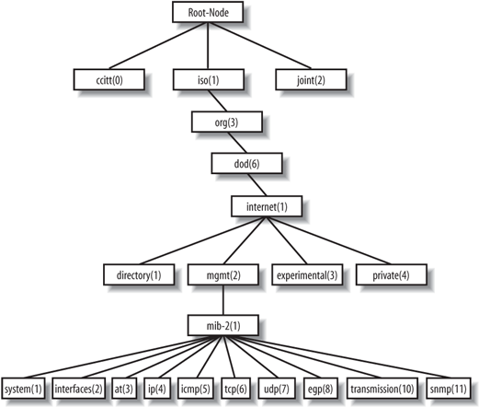
MIB-2 Subtree

Slide 80
MIB-2 Definitions
RFC1213-MIB DEFINITIONS ::= BEGIN
IMPORTS
mgmt, NetworkAddress, IpAddress, Counter, Gauge, TimeTicks FROM RFC1155-SMI
OBJECT-TYPE FROM RFC-1212;
mib-2 OBJECT IDENTIFIER ::= { mgmt 1 }
-- textual conventions
DisplayString ::= OCTET STRING
-- This data type is used to model textual information taken -- from the NVT ASCII character set.
-- By convention, objects -- with this syntax are declared as having SIZE (0..255)
PhysAddress ::= OCTET STRING
-- This data type is used to model media addresses. For many types of media, this will be in a binary representation.
-- For example, an ethernet address would be represented as a string of 6 octets.
-- groups in MIB-II
system OBJECT IDENTIFIER ::= { mib-2 1 }
interfaces OBJECT IDENTIFIER ::= { mib-2 2 }
at OBJECT IDENTIFIER ::= { mib-2 3 }
ip OBJECT IDENTIFIER ::= { mib-2 4 }
icmp OBJECT IDENTIFIER ::= { mib-2 5 }
tcp OBJECT IDENTIFIER ::= { mib-2 6 }
udp OBJECT IDENTIFIER ::= { mib-2 7 }
egp OBJECT IDENTIFIER ::= { mib-2 8 }
-- historical
-- cmot OBJECT IDENTIFIER ::= { mib-2 9 }
transmission OBJECT IDENTIFIER ::= { mib-2 10 }
snmp OBJECT IDENTIFIER ::= { mib-2 11 }

Slide 81
MIB-2 Groups
Subtree Name | OID | Description
System | 1.3.6.1.2.1.1 | Defines a list of objects that pertain to system operation, such as the system uptime, system contact, and system name.
Interfaces | 1.3.6.1.2.1.2 | Keeps track of the status of each interface on a managed entity (interfaces up/down, octets sent and received, errors and discards, etc. )
at | 1.3.6.1.2.1.3 | Network to physical address translation. (deprecated, exists for backward compatibility purposes)
ip | 1.3.6.1.2.1.4 | Tracks many aspects of IP, including IP routing.
icmp | 1.3.6.1.2.1.5 | Tracks things such as ICMP errors, discards, etc.
tcp | 1.3.6.1.2.1.6 | Tracks, among other things, the state of the TCP connection
udp | 1.3.6.1.2.1.7 | Tracks UDP statistics, datagrams in and out, etc.
egp | 1.3.6.1.2.1.8 | Tracks various statistics about the Exterior Gateway Protocol (EGP) and keeps an EGP neighbor table.
transmission | 1.3.6.1.2.1.10 | No objects are currently defined for this group, but other media-specific MIBs are defined using this subtree.
snmp | 1.3.6.1.2.1.11 | Measures the performance of the underlying SNMP implementation on the managed entity and tracks things such as the number of SNMP packets sent and received.

Slide 82
MIB-2 Groups’ Newer Versions
System Group
SNMPv2 MIB (RFC 1907)
Interfaces Group
IF-MIB (RFC 2863)
IP & ICMP Groups
IP-MIB (RFC 2011)
TCP Group
TCP-MIB (RFC 2012)
UDP Group
UDP-MIB (RFC 2013)
SNMP Group
SNMPv2 MIB (RFC 1907)

